Slide 1
Being Diligent
Bringing Data-Driven GRC, ESG & Assurance into the Boardroom
Dan Zitting
CEO, Galvanize (a Diligent Brand)

Slide 2
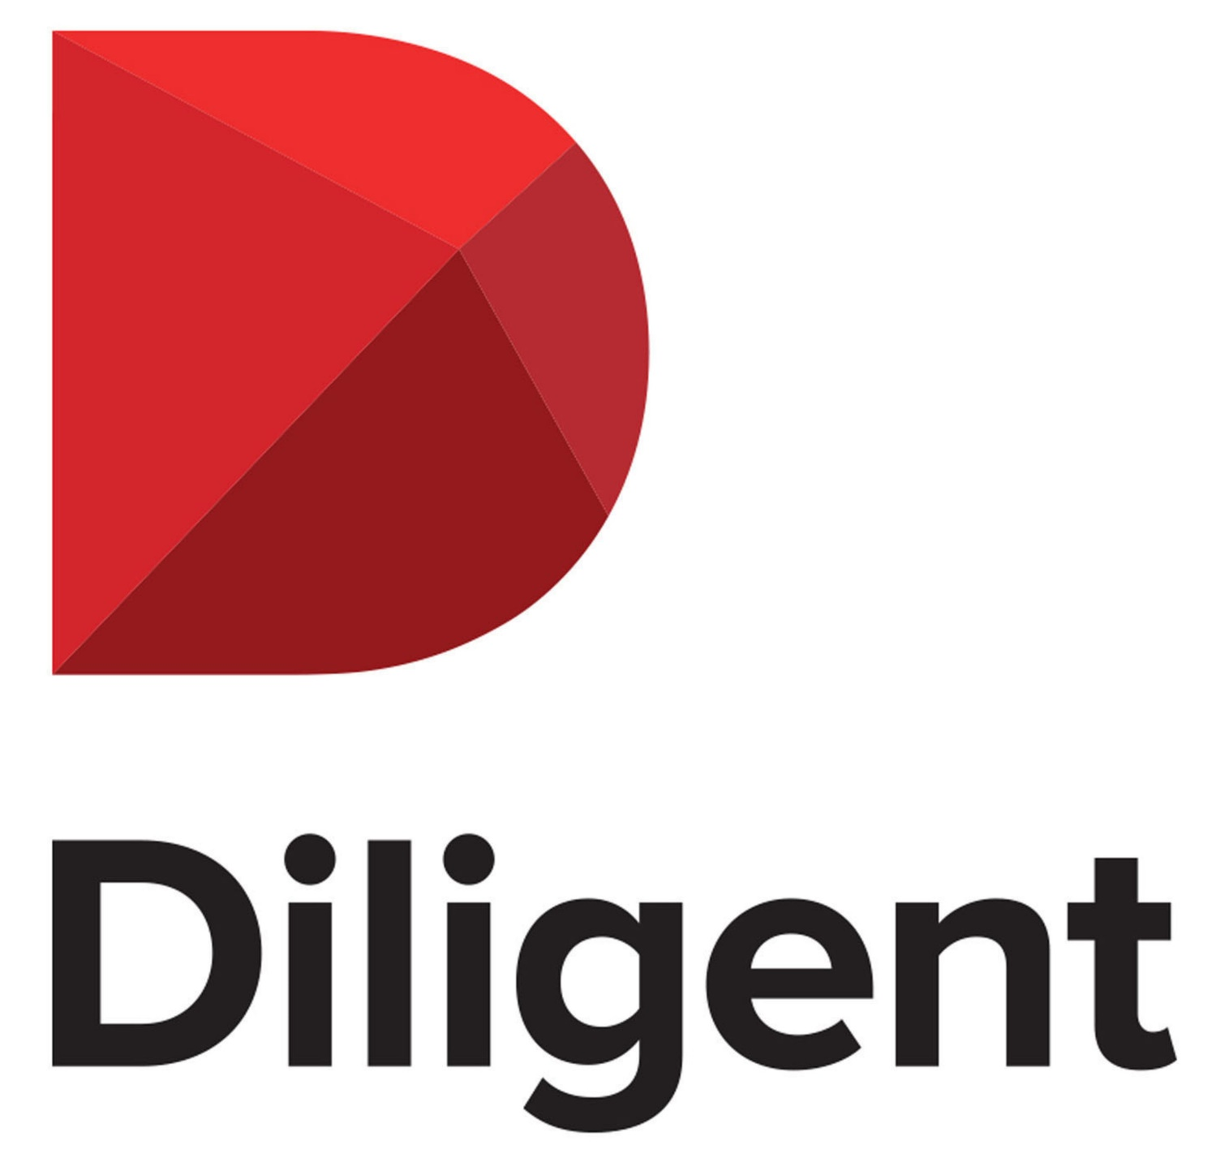
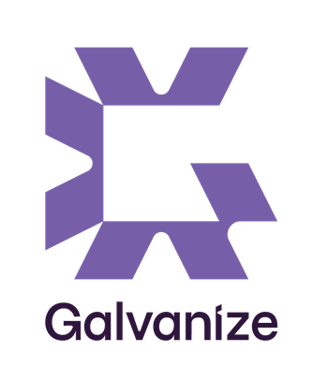
Many years supporting Rutgers & WCARS

Slide 3
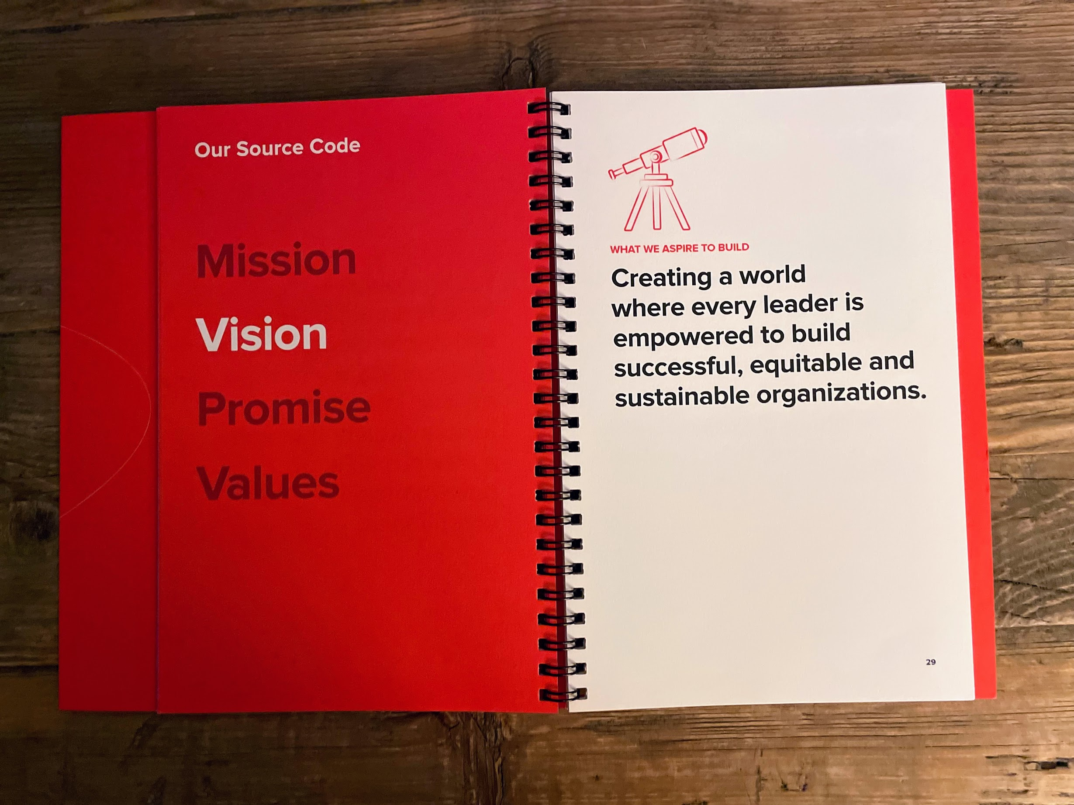
We are all stakeholders.
Every person, every community, the entire planet and the decisions organizations make impact us all.

Slide 4
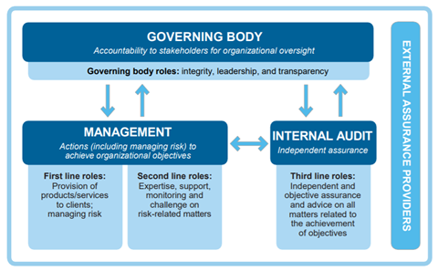
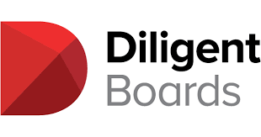
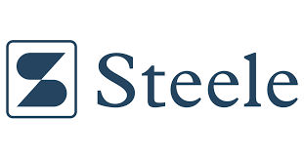
Integrated governance, in a single technology platform.
Solutions for GOVERNANCE of key organizational risks, culture, performance, etc. for the Board or similar governing body
4
GRC “Macro-Lifecycle”
Solutions for IMPLEMENTATION of risk assessment, internal controls and governance in the core business
Separately, solutions for regulators, external auditors, etc. for assessing governance in organizations they oversee
5
1
Solutions for ASSESSMENT and MONITORING of risks, controls and governance in legal, compliance, security, risk, etc. depts
Solutions for OBJECTIVE ASSURANCE on risks, controls and governance by internal audit
3
2

Slide 5
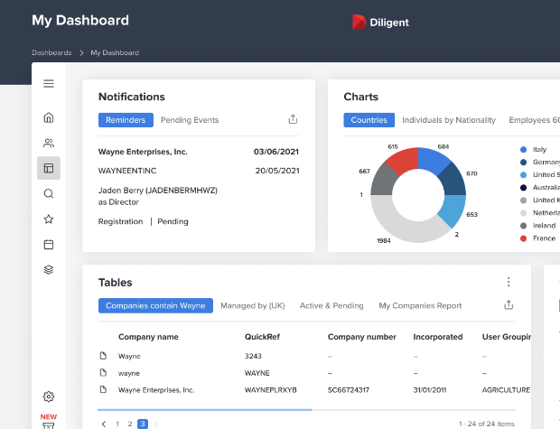
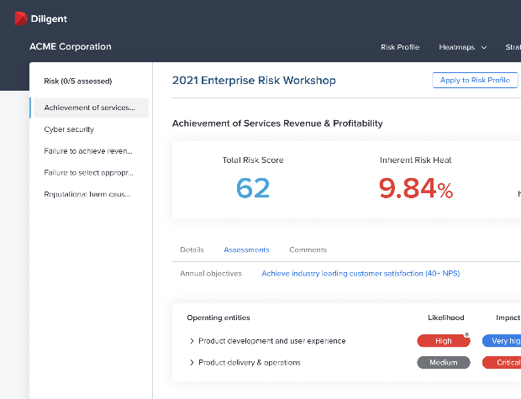
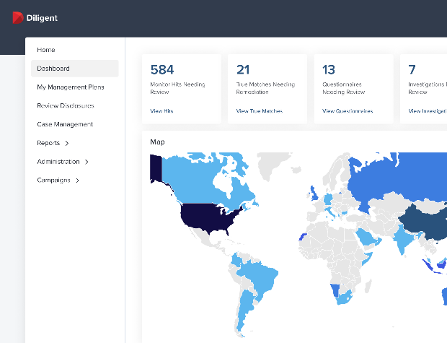
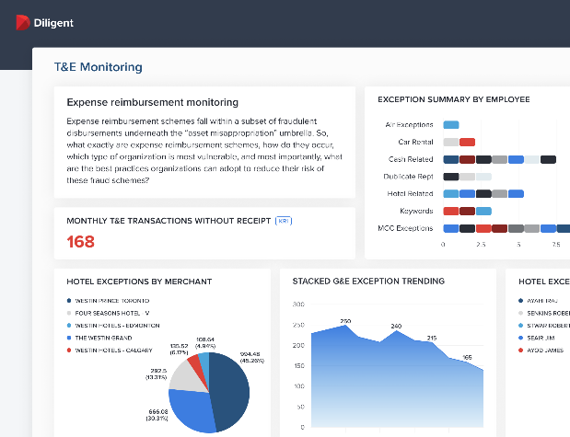
Modern GRC / ESG
Board and C-Suite
Modern
Governance
Modern
Risk
Modern
Compliance
Modern
Audit
Integrated Workflow
GRC Analytics
Robotic Process Automation with 70+ Integrations
Secure Communication and Collaboration

Slide 6
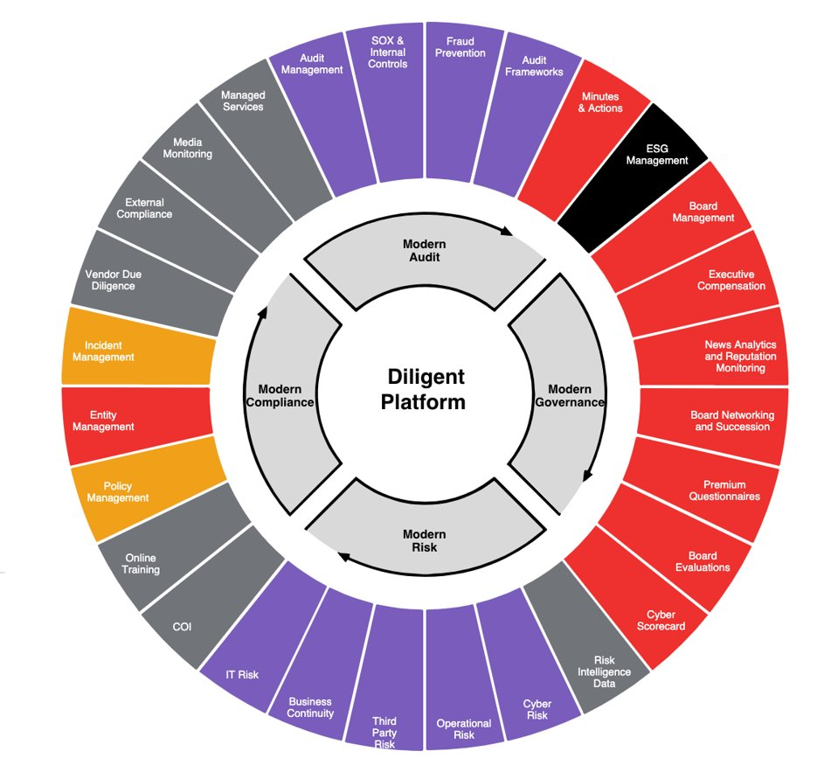
Board Governance/Publishing
Core GRC Platform
Integrated Solutions
Integrated Information & Intelligence

Slide 7
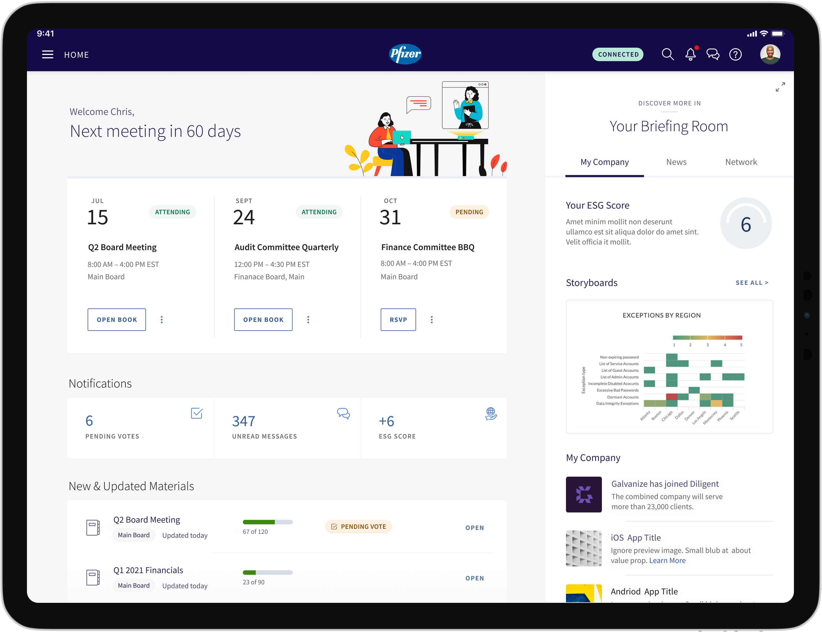
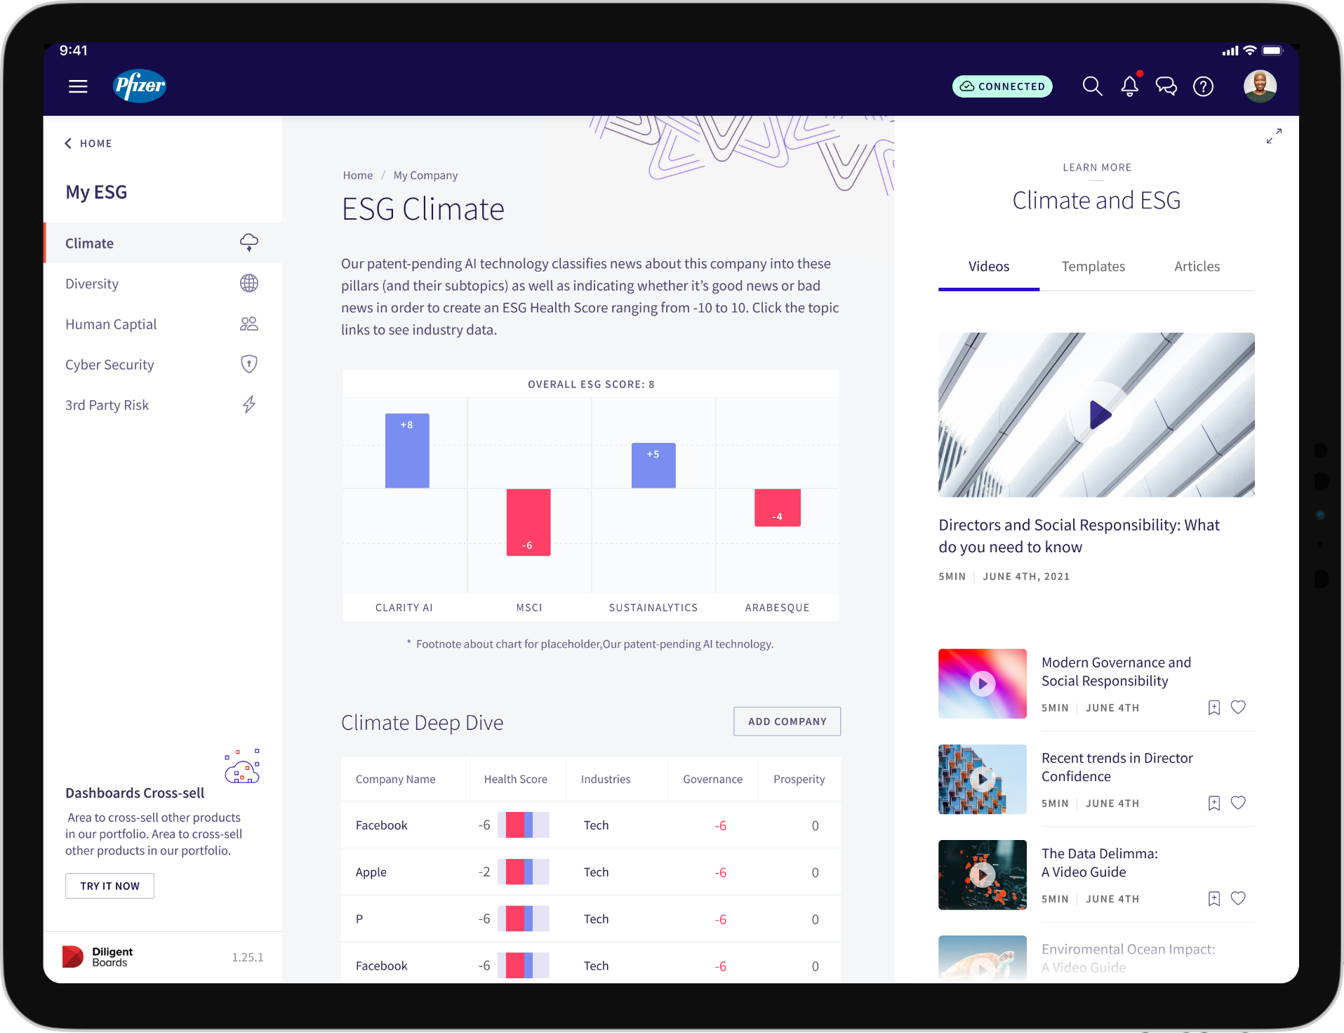
The most critical information, the most powerful leaders
>700,000 of the world’s most prominent business leaders live in Diligent’s applications… the best venue to share critical information.

Slide 8
Now for a few examples.

Slide 9
Diligent – The Global Leader in GRC
The Forrester Wave™: Governance, Risk, and Compliance Platforms, Q1 2020
Diligent named as A LEADER in The Forrester Wave™ Governance, Risk, And Compliance Platforms, Q1 2020 Report

